Slide 1

Spanner: Google’s Globally-Distributed Database
Presented by: Sonu Sourav , Sarthak Joshi

Slide 2

The Pain with MySQL
In 2005-2006 Google was using the MySQL at massive scale. Due to some maintenance they had to reshard the MySQL Clusters. This process took 2 years to complete. Google understood that they are growing very fast and these kinds of databases will be a pain in future.
Journey
They wanted the sharding features like the traditional NoSQL sharding that will take care of resharding and rebalancing, more availability, less downtime, horizontal scale and globally distributed. Thus, Spanner was born.

Slide 3
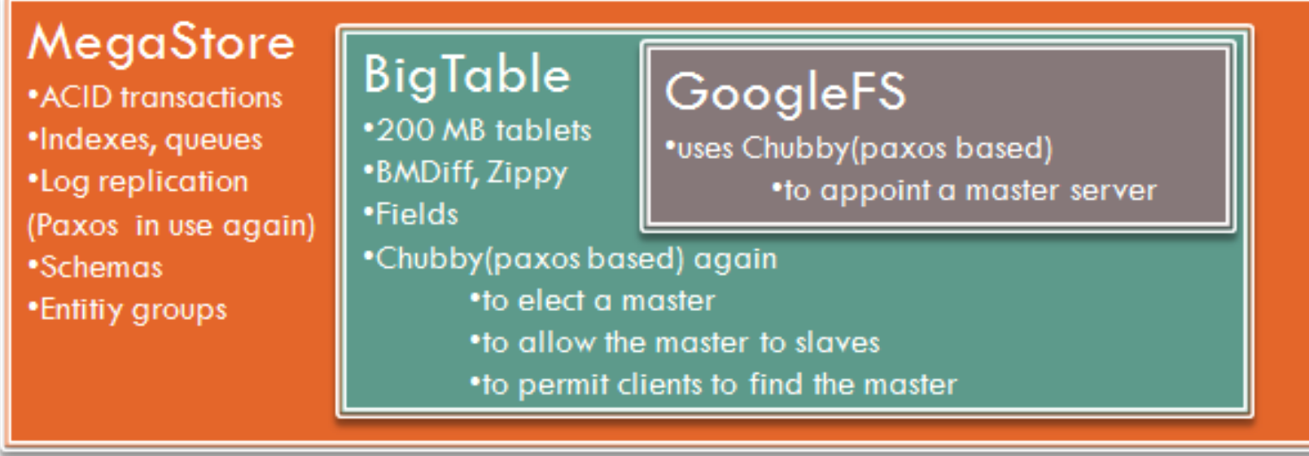
Bigtable (2008):
BigTable is a distributed storage system that is structured as a large table: one that may be petabytes in size and distributed among tens of thousands of machines.
Google received complaints for its performance in application requiring strong consistency guarantees for geo-replicated sites.
It is also difficult to use for complex, evolving schemas.
Megastore (2011):
Megastore blends the scalability of a NoSQL datastore with the convenience of a traditional RDBMS.
It supports synchronous replication by providing semi-relational data model.
But it offers low consistency across global data replication and incurs poor write throughput

Slide 4
Features of Spanner?
Overview
Lock-Free distributed read only transactions
External consistency of writes
Temporal multiple versioning
Schematized, semi-relational database with associated structured query language
Applications control replication and placement
All of this because of TrueTime

Slide 5
In a Nutshell
Spanner is Google's scalable, multi-version, globally-distributed, and synchronously-replicated database. Spanner supports non-blocking reads in the past, lock-free read-only transactions, and atomic schema changes. In order to support externally-consistent distributed transactions at global scale, it uses a novel TrueTime API that exposes clock uncertainty.
Spanner evolved from a Bigtable-like versioned key-value store into a temporal multi-version database. Data is stored in semi-relational tables, and Spanner provides a SQL-based query language and supports general-purpose long-lived transactions (e.g, for report generation —on the order of minutes).
Data is versioned, and each version is automatically timestamped with its commit time by the TrueTime API. Spanner provides externally consistent reads and writes, and globally-consistent reads across the database at a timestamp.

Slide 6
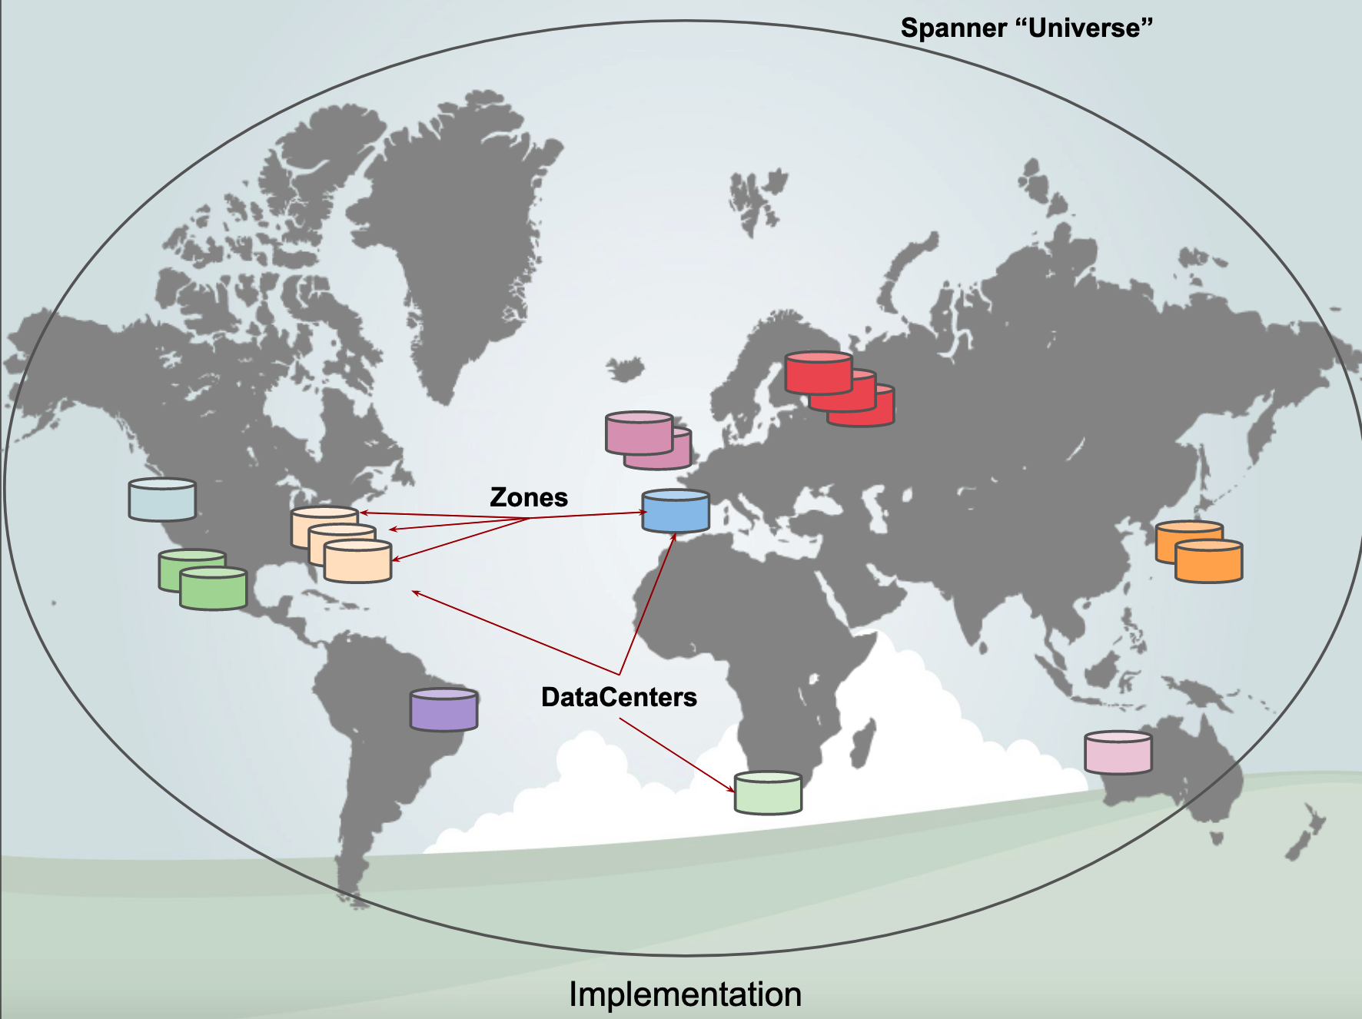
Spanner Structure

Slide 7
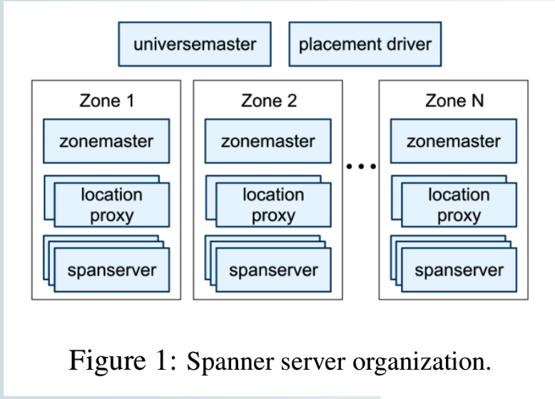
Zone Server Organization
Zonemaster (1 per zone): Assigns data to the span servers
Spanserver (100 - 3000 per zone): Serves data to the clients
Proxies: Used by clients to locate span servers with the correct data (shard lookup) these are used to prevent bottleneck at zonemaster
Universe Master: Has a console with status information of all zones
Placement driver: Handles data movement for replication or load balancing purposes

Slide 8
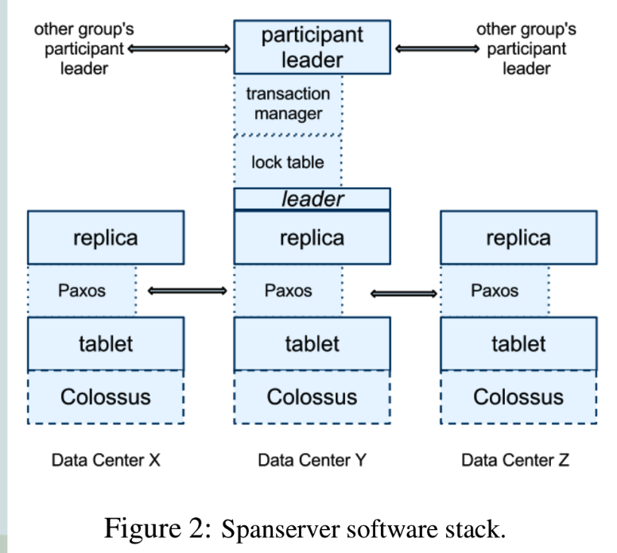
Zone Server Stack
Each tablet gets a Paxos state machine that maintains its log and state in the tablet (Paxos writes twice)
Paxos has long lived leaders (10 seconds) and is pipelined to improve for WAN latencies
Paxos is used to maintain consistency among replicas; every write must initiate at the Paxos leader.
The set of replicas is collectively a Paxos group

Slide 9
Zone Server Stack
Each leader maintains a lock table with state for two phase locking, mapping range of keys to lock states.
Transaction manager is used to implement distributed transactions and to select a participant leader, which coordinates Paxos between participant groups. Colossus is the distributed file system which is derived from the GFS. A high performance file system is needed for a super database.

Slide 10
Storage Data Model
(key:string, timestamp:int64) →string
Tablet: a bag of timestamped key,val pairs as above
Tablet’s state is tracked and stored with B-tree-like files and a write-ahead log. Data storage is on a distributed file system (Colossus, the successor to GFS at Google).
Tablets are optimized data structures first implemented by BigTable to track data by row/column position (the keys) and their locations on GFS.
Tablets (for now) can be seen as the basic unit of replication/sharding.

Slide 11
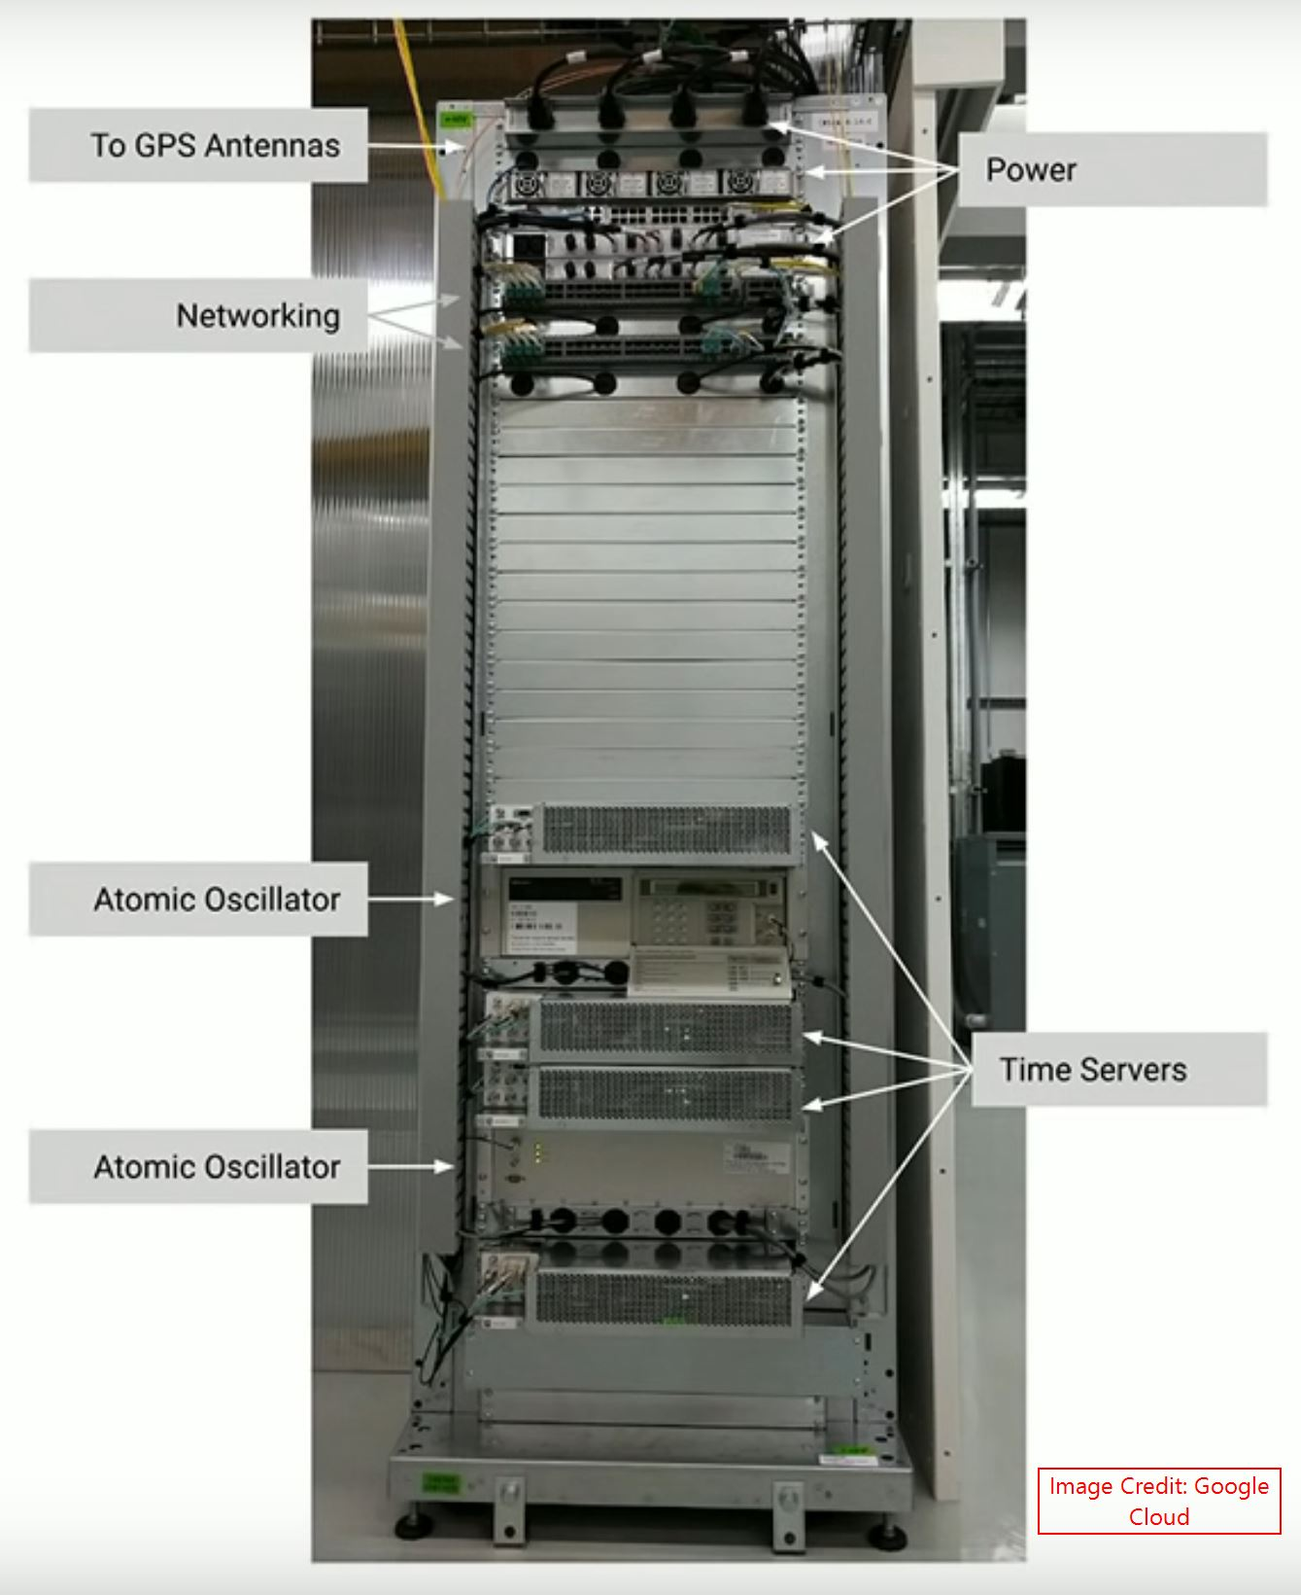
Global strong Consistency:
Spanner supports the strong consistency across all the nodes(Globally). If you write something on US region, you can read that same data from the Asia region or any other region. How they implemented this logic? Its called TrueTime.

Slide 12
External Consistency
External consistency is equivalent to linearizability in which the commit order adheres to global clock.
Property: If a transaction T1 commits before another transaction T2 starts, then T1’s timestamp is smaller than T2’s.
Enabler: True time API provides interval based global time to establish the above property.
Application: This helps to implement lock free distributed read transactions.

Slide 13
Timestamps & Global Clock
Strict two-phase locking for write transactions
Assign timestamp while locks are held
Acquired locks
Release locks
T
Pick s = now()

Slide 14
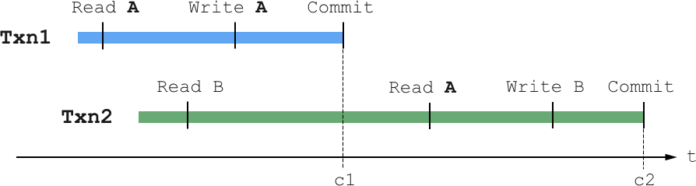
Timestamp Invariants
Timestamp order == commit order

Slide 15
TrueTime Api
“Global wall-clock time” with bounded uncertainty Idea: There is a global “true” time t TT.now() = [earliest, latest] ϶ t.
TT.now().earliest definitely in the past
TT.now().latest definitely in the future
TT.now()
time
earliest
latest
2*ε

Slide 16
Timestamps and TrueTime
Acquired locks
Release locks
T
Pick s = TT.now().latest
s
Wait until TT.now().earliest > s
Commit wait
average ε
average ε

Slide 17
Commit Wait and Replication
Start consensus
Achieve consensus
Notify slaves
Acquired locks
Release locks
T
Pick s
Commit wait done

Slide 18
TrueTime Architecture
GPS timemaster
GPS timemaster
GPS timemaster
GPS timemaster
Atomic-clock timemaster
GPS timemaster
Client
Datacenter 1
Datacenter 2
…
Datacenter n
Compute reference [earliest, latest] = now ± ε
Marzullo’s Algorithm: An agreement algorithm used to select sources for estimating accurate time from a number of noisy time sources.
Notes:
Bad hosts are evicted
Timemasters check themselves against other timemasters
Clients check themselves against timemasters

Slide 19
TrueTime implementation
now = reference now + local-clock offset
ε = reference ε + worst-case local-clock drift
ε
+6ms
200 μs/sec
reference
uncertainty
time
0sec
30sec
60sec
90sec

Slide 20
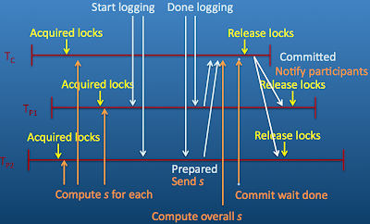
Concurrency control
Read-write transactions use 2-phase locking and 2-phase commit. First, the client issues reads to the leader replica of the appropriate group, which acquires read locks and then reads the most recent data.
When a client has completed all reads and buffered all writes, it starts 2-phase commit. Read-write transactions can be assigned commit timestamps by the coordinator leader at any time when all locks have been acquired, but before any locks have been released.
For a given transaction, Spanner assigns it the timestamp that the coordinating leader assigns to the Paxos write that represents the transaction commit. To wait out the uncertainty in TrueTime, there is a Commit Wait: The coordinator leader ensures that clients cannot see any data committed by T_{i} until TT.after(s_{i}) is true.

Slide 21
Commit Wait and 2-Phase Commit
Start logging
Done logging
Acquired locks
Release locks
T_{C}
Committed
Notify participants of s
Acquired locks
Release locks
T_{P1}
Acquired locks
Release locks
T_{P2}
Prepared
Send s
Compute s for each
Commit wait done
Compute overall s

Slide 22
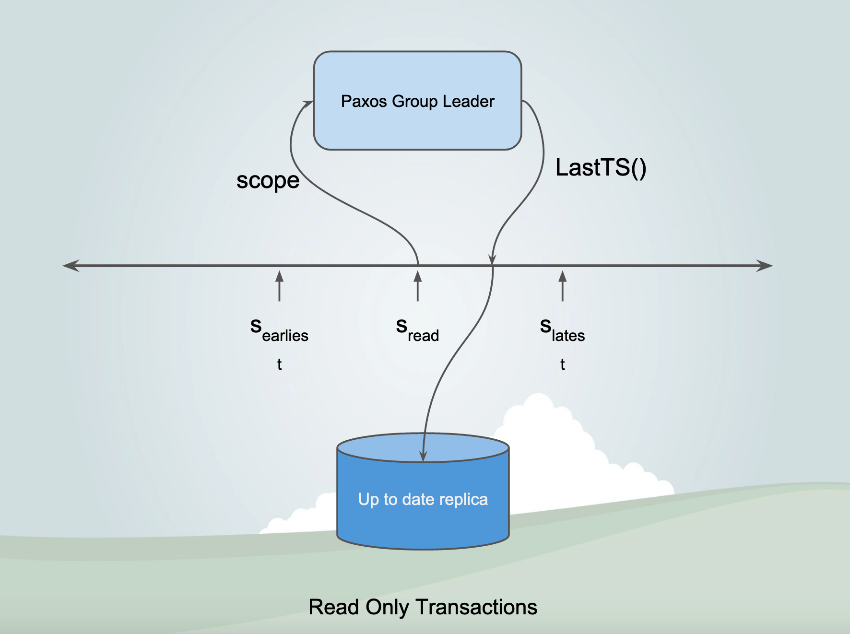

Slide 23
What If a Clock Goes Rogue?
Timestamp assignment would violate external consistency
Empirically unlikely based on 1 year of data
Bad CPUs 6 times more likely than bad clocks

Slide 24
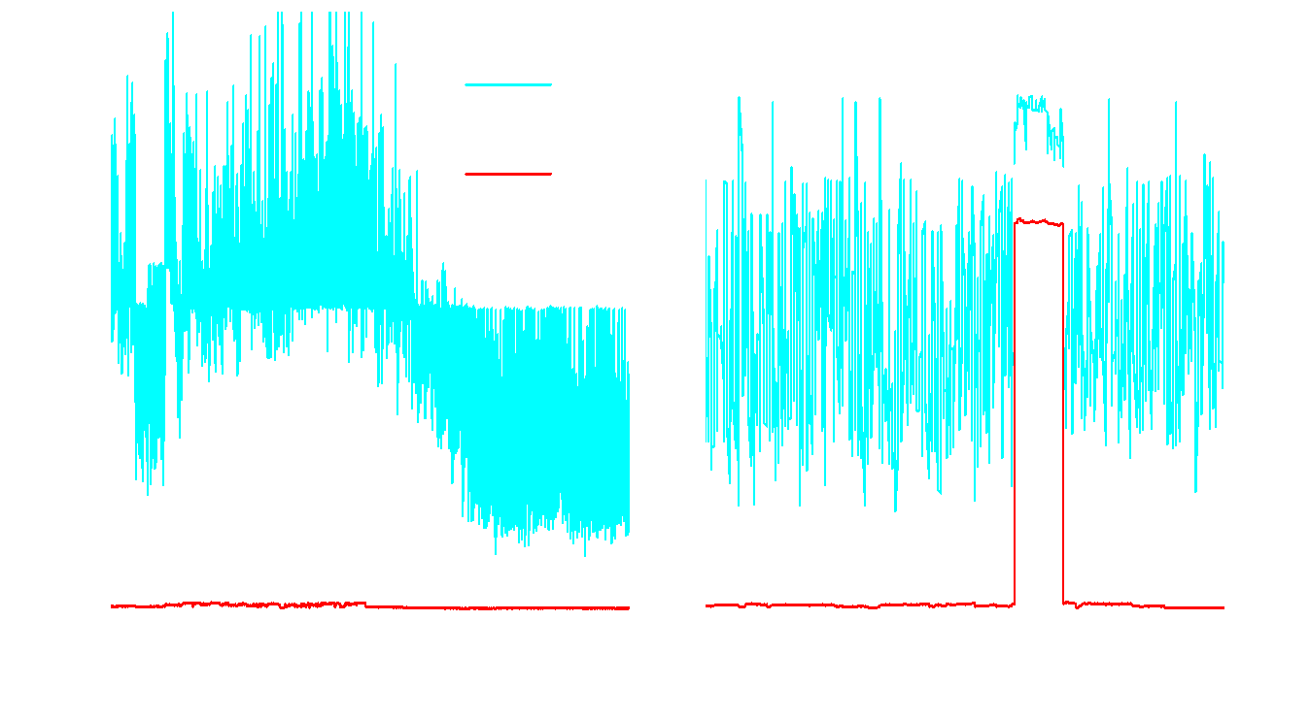
Network-Induced Uncertainty

Slide 25
Future Work
Improving TrueTime
Lower ε < 1 ms
Efficiently support rich query patterns
Spanner schema language .
Automatic load-based resharding.
Optimistically parallel reads .
Increase performance for complex queries as it is based on key-value access.

Slide 26
References
http://muratbuffalo.blogspot.com/2013/07/spanner-googles-globally-distributed_4.html
https://www.infoq.com/presentations/spanner-distributed-google/#downloadPdf/
https://www.youtube.com/watch?v=C75kpQszAjs
https://thedataguy.in/internals-of-google-cloud-spanner/

Slide 27
Thank You!

